Slide 1
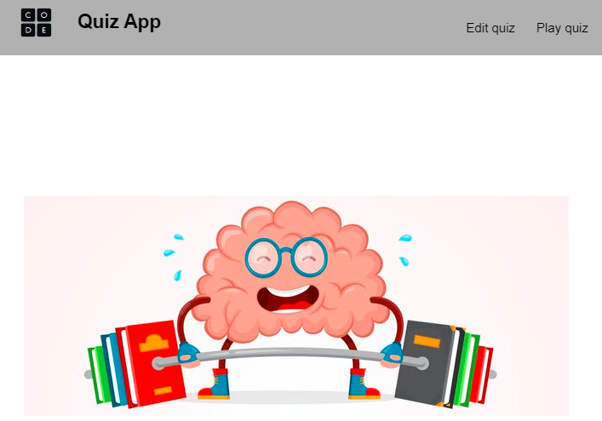
CHAPTER 2
CREATE A
QUIZ

Slide 2

10 MIN
DEMO TEACHER
Edit the quiz questions
Play the quiz
Let’s work on last year’s project !
Notes:
TEACHER
- Start to demo the project on /1 - teacher demo

Slide 3

PRACTICE LEARNING OBJECTIVES
Separate your website into 2 sub views
Use the local storage to save/load data
Use the dataset on HTML elements
Create a dialog to edit or add a new question

Slide 4

UNDERSTAND CODE FIRST!
In this practice you will be asked to extend an existing project. You first need to understand the existing variables and functions, before starting your code!

Slide 5
5 MIN
STEP 1
The application is composed of 3 views: start, quiz, score
start
quiz
scoreContainer
question
QUESTION ??
choices
A
B
Start QUIZ
Score : 80%
Answer A
Answer B
Answer C
Answer D
C
D
TODO
Complete the hide / show functions to display only the start view at the beginning

Slide 6
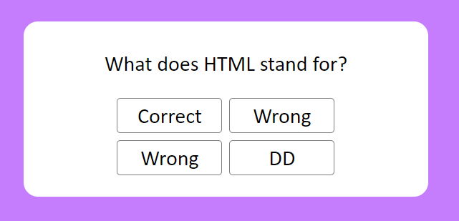
30 MIN
STEP 2
Display quiz and compute score
{
title: "What does HTML stand for?",
choiceA: "Correct",
choiceB: "Wrong",
choiceC: "Wrong",
correct: "A",
},
TODO:
Try to understand the meaning of the 3 global variables: questions, runningQuestionIndex, score
Complete renderQuestion()
When is the function checkAnswer(answer) called, and what does it do ?
In renderScore(): compute the final score in percentage

Slide 7
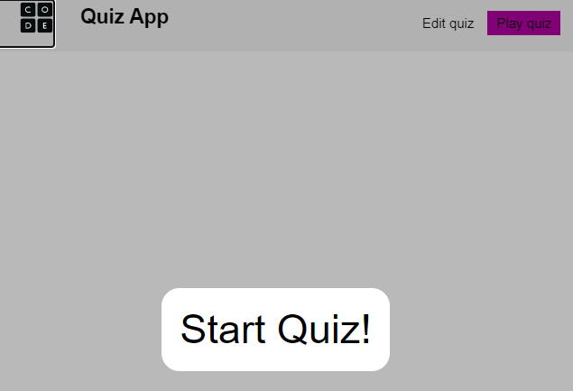
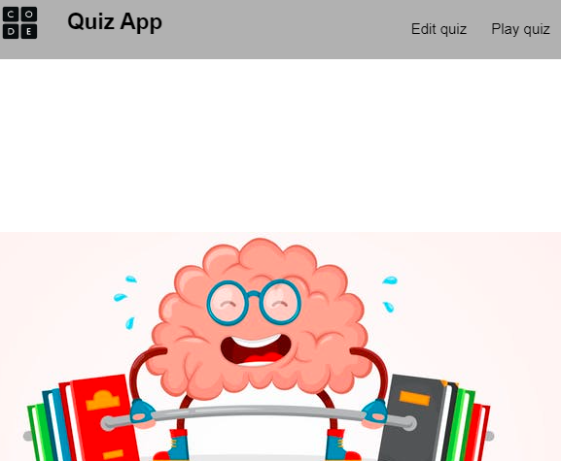
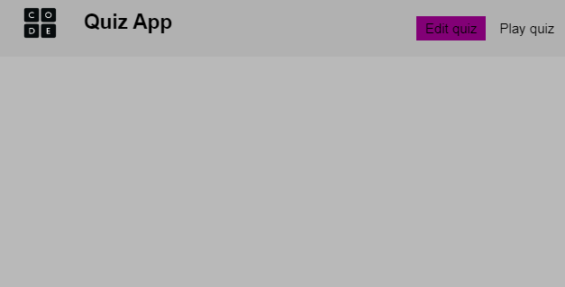
Refactor the project into 2 sub views
/views/play/play.html : the view to PLAY the QUIZ
/index.html : The start page :
/views/edit/edit.html : the view to EDIT the QUIZ

Slide 8
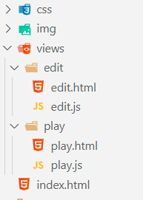
20 MIN
STEP 3
Refactor the project into views
TODO
Understand the project structure
HTML and JS to manage the QUIZ edition
HTML and JS to manage the QUIZ play
Update the index.html to link with the 2 sub views
Don't forget to include the menu in the 2 sub views, and to display the selected menu item
Use the CSS class active to style the active menu item
Transfer your previous code from STEP 2 to the sub view PLAY

Slide 9

Now, let’s use the Local storage
to store the QUIZ on the browser data
STEP 4

Slide 10


Browsers allow you to save
Up to 10 Mb of data locally
LOCAL STORAGE
WRITE
READ

Slide 11
The local storage is a dictionary
local Storage = { key: value, key: value,… }
WRITE
READ

Slide 12
Set a value
localStorage.setItem("amount", 12);
GLOBAL
VARIABLE
KEY
VALUE
Get a value
let amount = localStorage.getItem("amount");
KEY

Slide 13
Clear all
localStorage.clear();
Clear only 1 item
localStorage.removeItem("amount");
KEY

Slide 14
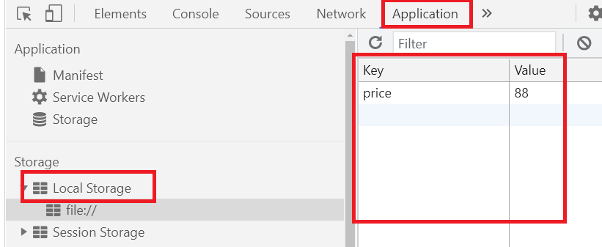
How to see your local storage in Chrome
DEMO

Slide 15
30 MIN
STEP 4
Save/load the QUIZ on local storage
TODO
Code the function saveQuestions() to save the list of questions to the local storage
You can use "questions“ as a key to store question in the local storage
Code the function loadQuestions() to load the list of questions from the local storage
Warning: if there is no data on local storage, you should not update the global variable questions
Test your local storage save/load functions :
Launch saveQuestions() when the view PLAY is displayed
Check the questions are saved on the local storage
Replace saveQuestions() by loadQuestion() when starting to play quiz
Change 1 question on the local storage
Reload the page : check we load question from the local storage

Slide 16
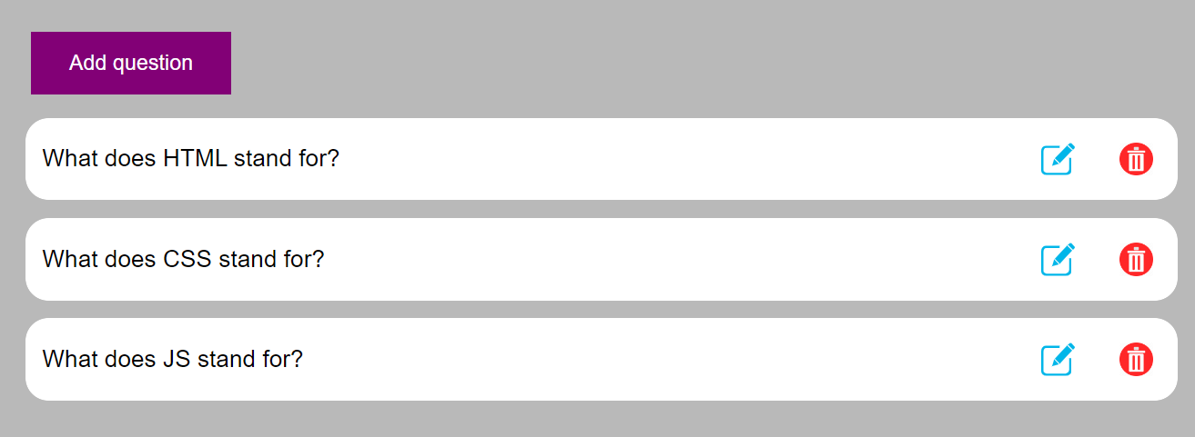
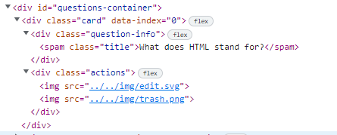
45 MIN
STEP 5
Edit quiz - List all questions
TODO
Code the function renderQuestions() to display all existing questions with the right HTML/CSS attributes
Complete the function removeQuestion() to remove the question when clicking on remove button
Warning: you need to understand how to use dataset to keep the index of the question on the question card

Slide 17
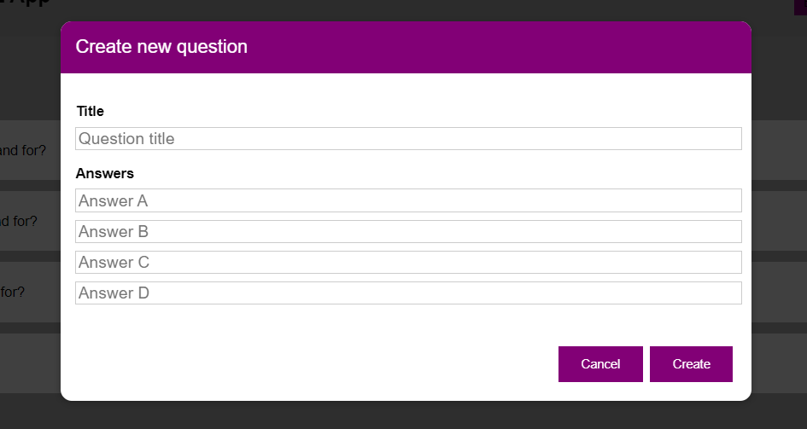

45 MIN
STEP 6
Create a dialog and add questions
TODO
On EDIT html: call the right functions when clicking on buttons
On EDIT JS: Code the functions onCreate() , onAddQuestion() , onCancel()

Slide 18
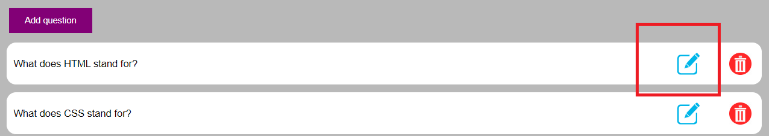
45 MIN
STEP 7
Edit a question
TODO
On EDIT JS : Code the functions editQuestion (event)
Keep the ID of the edited question using a global variable
On EDIT JS : Update the functions onCreate ()
This function should manage to edit the edited question or create a new question, depending on the situation

Slide 19
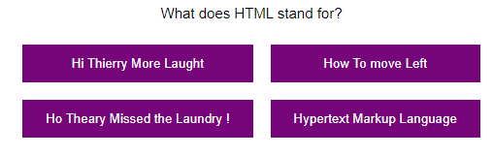
20 MIN
STEP 8
Add a progress bar
TODO
Add a progress bar on the PLAY view to see the progress in %

Slide 20
BONUS

Slide 21
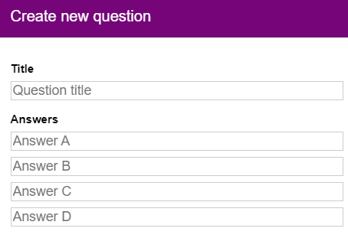

BONUS 1
On the DIALOG, add a way to select the GOOD answer

Slide 22
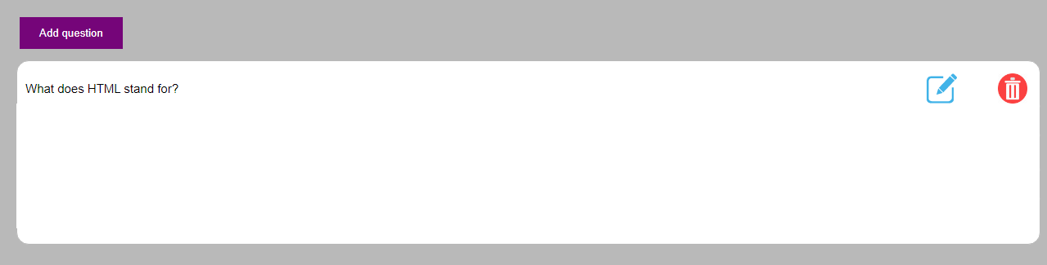
BONUS 2
On the EDIT VIEW, display the 4 possible answers and the correct answer
Cisco and Super Start
Cascading Style Sheets
Ci So Sa
I don't know !

